Slide 1
FCC Fall 2018 Convocation

Slide 2
Agenda
Color Guard and Pledge
Welcome
New Faces & New Opportunities
Instructional Focus
Student Success Teams
Accreditation
Break
State of the College
Key Note Speaker
Q&A

Slide 3
Color Guard and Pledge
Mr. Christopher Washington, ASG President

Slide 4
Dr. Paul Parnell
Welcome Back

Slide 5
New Faces and New Opportunities
Welcome to those new to the FCC Family!
Congratulations to our promoted employees!
Notes:
Have faculty stand…acknowledge promotions and new interims…
XX New retires 17 last year…
XX new Faculty round of applause

Slide 6
Aaron Acevedo Financial Aid Assistant I

Slide 7
Mufadhal Al-Kuhlani Biology Instructor

Slide 8
Sean Boyd Geography Instructor

Slide 9
Chris Brady

Slide 10
Peter Cacossa Fire Technology Coordinator

Slide 11
Ernesto Cazares General & CVP Counselor

Slide 12
Donna Cooper Dean of Library & Learning Support

Slide 13
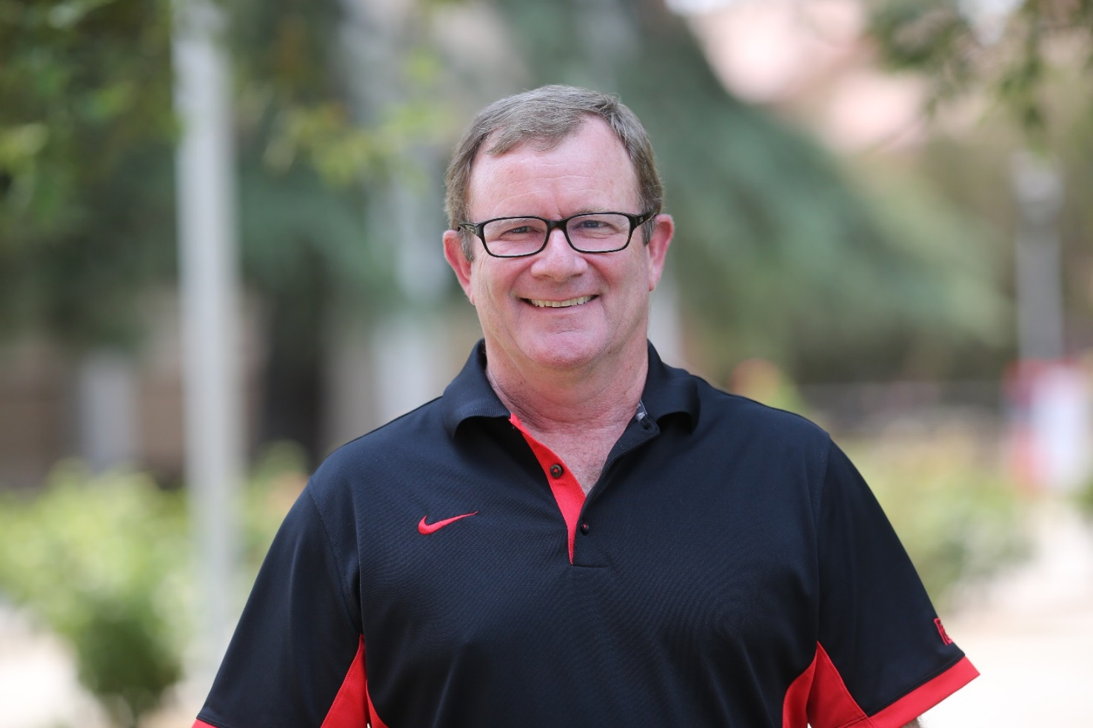
Andy Doris Equipment Manager

Slide 14
Caleb Duarte Art Instructor

Slide 15
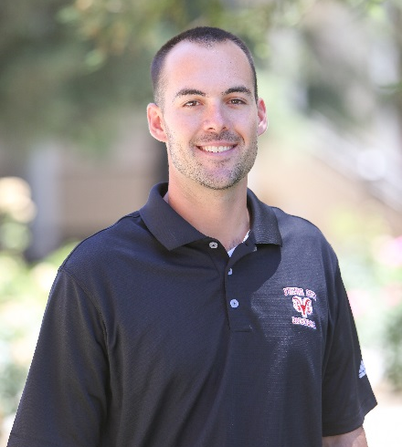
Alex Fletcher Women’s Basketball Coach

Slide 16
Andreas R. Hernandez Director of Admissions & Records

Slide 17
John Hsiao English Instructor

Slide 18
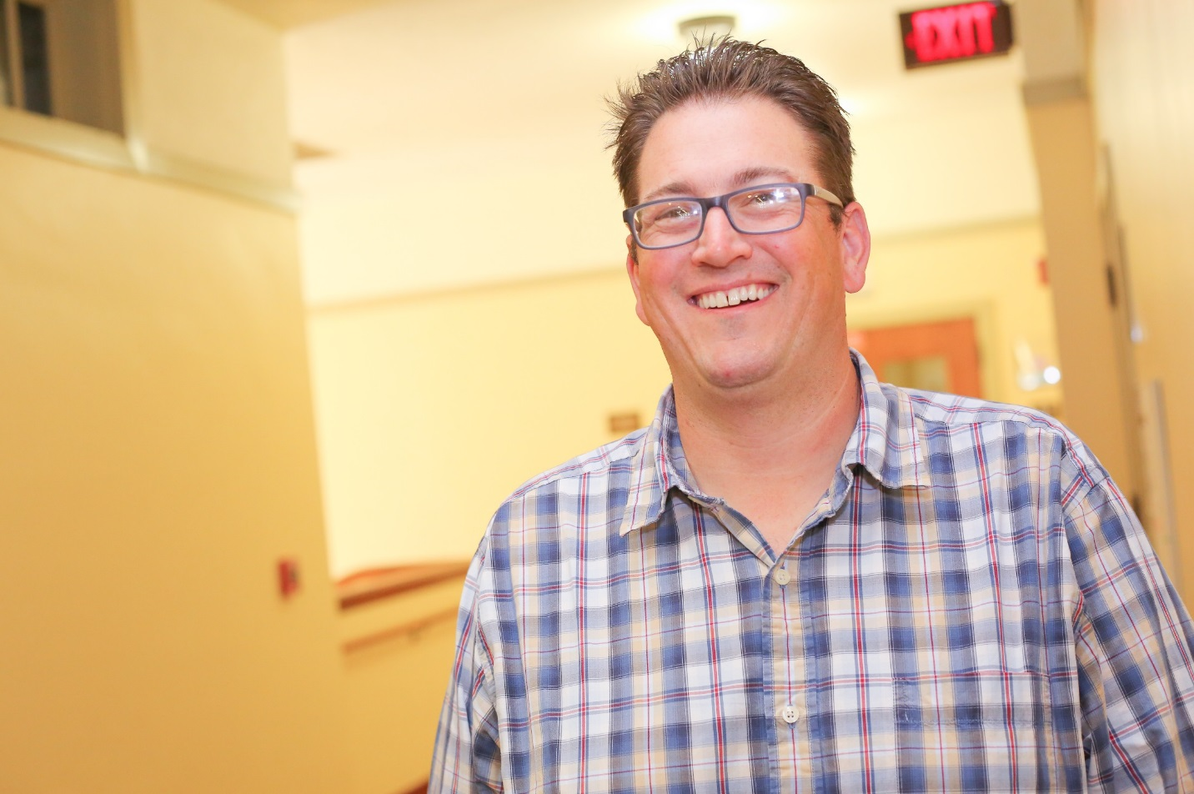
Paul Lucckesi Music Instructor

Slide 19
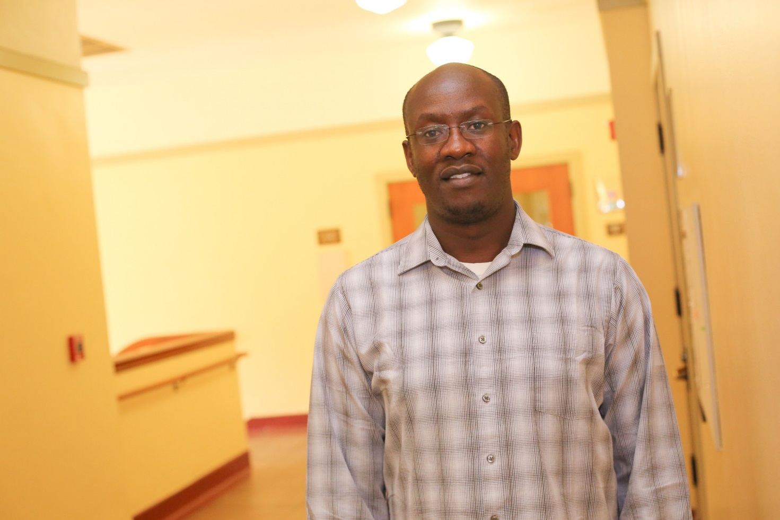
Eliud Mushibe Chemistry Instructor

Slide 20
Robert Pimentel VP Educational Services/Institutional Effectiveness

Slide 21
Dale Putman Maintenance Mechanic Instructor

Slide 22
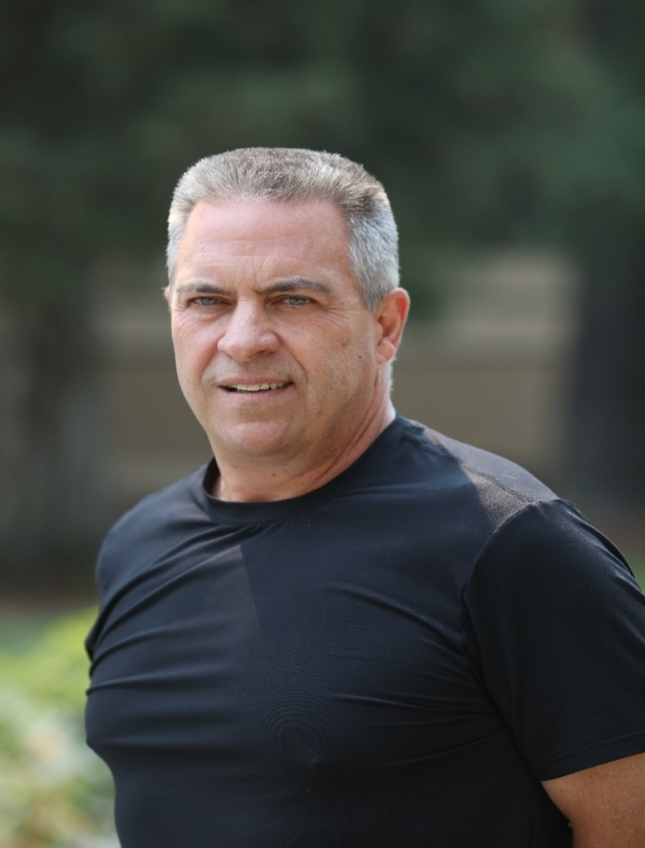
Doug Schreiner Acting Director of Technology Support Services

Slide 23
Jessica Shadrick Athletics Counselor

Slide 24
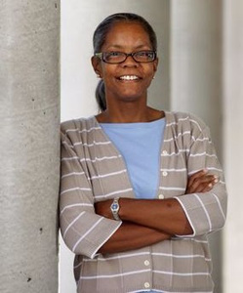
Carla Walter Interim VP of Administrative Services

Slide 25
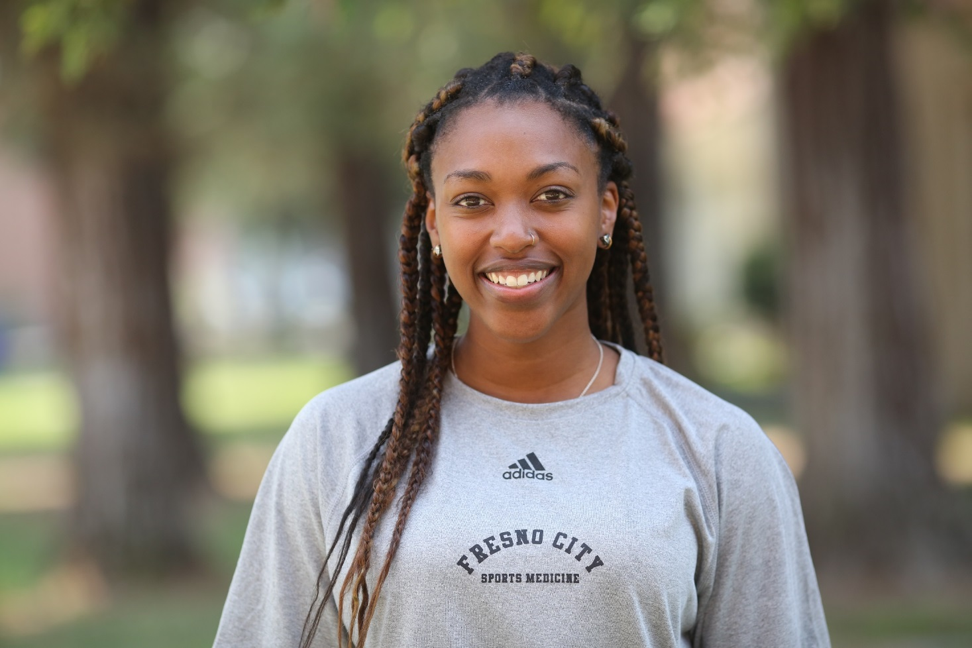
Ashley Watkins Athletic Trainer

Slide 26
Elisha Wilson Music Instructor

Slide 27
Tony Yang Office Assistant – Admissions & Records

Slide 28
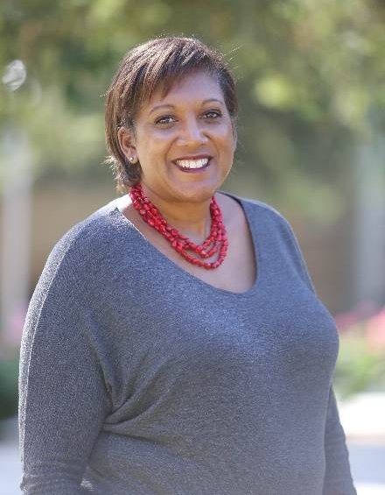
Pamm Zierfuss-Hubbard Athletic Director

Slide 29
Promotions
Virginia Her - Accounting Clerk II
Carlos Puente – Night Custodial Manager
Amanda Romero, OA 1 (3/7/2018)
Gabrielle Jimenez, OA 1 (May board)
Charlotte Harmon, Library Services Specialist (May board)
Anthony Estrada, custodian (May 2018)
Luis Jauregui Martinez (june 2018), custodian
Elaine Sasaki (June 2018) Bookstore Sales Clerk III
Angelica Gonzales (June 2018), Early Childhood Education Associate
David Clacher (June 2018), Financial Aid Assistant II
Ashley Watkins (June 2018), Athletic Trainer
Tiffany Martinez, Early Child Ed Specialist (6/26/2018)
Lacey Easton, Sign Language II (7/16/18)
Kimeka Simmons, Sign Language II (7/16/2018)

Slide 30
Instructional Focus
Don Lopez
Vice President of Instruction
Notes:
Good Morning
Welcome to Fall 2017 Convocation
My portion of the presentation today will focus on our efforts around enrollment and the changes we have made or will be making to our facilities

Slide 31
Flex Day Reminders
eLumen
Guided Pathways
AB-705
Open Educational Resources

Slide 32
Technology Update
Summer 2018
700 lab computers installed
Fall 2018
100 Faculty Computers

Slide 33
Accreditation Recommendation
SLO on the syllabus
Software platform that integrates with eLumen and Canvas
Taskforce to review two solutions that have been identified
Review and test
Purchase Product and implement in Spring 2019

Slide 34
Enrollment
Notes:
Last year I presented similar information regarding our enrollment and based upon the upward trend of FTES over the past five years things looked pretty good for FCC to reach levels close to those experienced in the 2010-2011 academic year

Slide 35
FCC FTES (Full-time Equivalent Students)
Notes:
As you can see we grew our FTES this past academic year and as of yesterday we had surpassed pour FTES Target for Fall 108 of 7746.

Slide 36
320 Report for 2017-2018
Part | FUND METHOD | 2017SU PUSH | 2017FA | 2018SP | 2018SU | Total
II | WEEKLY | 0.00 | 5,989.01 | 5,472.83 | 0.00 | 11,461.84
III | DAILY | 953.91 | 575.01 | 752.62 | 755.59 | 3,037.13
IV CRED | POSATT | 253.43 | 457.72 | 618.70 | 14.20 | 1,344.05
Carryover | PosAtt | 0.00 | 41.00 | 0.00 | 0.00 | 41.00
IV NCRED | NONCRED | 45.81 | 142.55 | 254.14 | 0.32 | 442.82
V | WRKEX WEEKLY | 0.00 | 624.46 | 672.43 | 0.00 | 1,296.89
VI | WRKEX DAILY | 249.80 | 227.69 | 269.35 | 235.46 | 982.30
Totals (credit & non credit) |  | 1,502.95 | 8,057.44 | 8,040.07 | 1,005.57 | 18,606.03
Total Credit |  | 1,457.14 | 7,914.89 | 7,785.93 | 1,005.25 | 18,163.21
Total Non Credit |  | 45.81 | 142.55 | 254.14 | 0.32 | 442.82

Slide 37
New Funding Formula
The Aim of the New Formula
70-20-10 Split
70% – Base Allocation
20% – Equity Allocation
10% – Student Success Allocation
Notes:
Phased approach this year 70-20-10 and eventually 60-20-20
Encourage progress toward the Vision for Success accepted by the Board of Governors.
Recognize that districts should receive additional resources to help certain groups of students who face especially high barriers to success meet those goals.
Make additional resources most useful to community college districts by allocating them through a formula that is sufficiently simple, transparent, and stable.
70%: Generally consistent with the system’s existing funding practices—with modifications to calculations to “smooth out” changes in enrollment.
20%: Equity Allocation, would fund districts based on the number of low-income students and first-generation college-going students enrolled
10%: Student Success Allocation, would fund districts based on a set of progress, completion, and earnings measures—with additional funding for outcomes of low-income students and first-generation college going students
The Governor’s Budget also asked the Chancellor’s Office to present recommendations on the consolidation of existing categorical programs. The Chancellor’s Office recommends the consolidation of the Student Success and Support Program, the Student Success for Basic Skills Program, and the Student Equity Program, with a clear focus on equity as part of the new program.

Slide 38
Enrollment Strategies
K-12 Partnerships
Dual Enrollment
Remote Locations
DSHS – Middle College
Central Valley Promise
Online Learning
Guided Pathways
15 to Finish
Non-Credit Offerings
Increased CTE Programs
Enhanced Support Services
Notes:
So what are we doing about it.
Our enrollment strategies span a range of activities.
We are focusing on the expansion of our K-12 partnerships through
Dual enrollment,
the use of FUSD locations in the evenings to offer our courses, and
the development of a Middle College on the FCC campus in the near future.
Central Valley Promise which I will speak about in a moment
Other strategies include
The expansion of Distance Education,
Guided Pathways to help our student progress through their education in clearly defined ways
National Initiatives on College Completion (15 to finish)
Expansion of our Non-Credit Offerings
Increased CTE Program Offering through the Strong Workforce Funding from the State
And Increasing Student Support Efforts (for example ETC)

Slide 39
Central Valley Promise
Notes:
We have been talking about the Central Valley Promise for some time now but for those new to FCC this is a joint effort between FUSD, SCCCD, and CSU Fresno to Increase the % of college going students in the Central Valley
Numbers for Fall 2018 –
1519 students were eligible
788 CVP eligible students were registered for classes at FCC
368 students in the cohort (this number could drop down if students don’t complete all of the requirements)

Slide 40
Dual Enrollment
Notes:
AS I mention one of the strategies we are using to help grow FTES for the College and provide opportunities for our students to get a jump on college is Dual enrollment

Slide 41
DuE by the numbers
Terms | Sections | Enrollment | FTES
Fall 2015 | 6 | 66 | 6.5
Spring 2016 | 43 | 702 | 102
Fall 2016 | 16 | 206 | 28
Spring 2017 | 62 | 1,500 | 126
Fall 2017 | 35 | 770 | 59
Spring 2018 | 99 | 2,002 | 185
Fall 2018 | 80 | 1000* | 70*
Spring 2019 | 148 | 3000* | 200*
* Projections
Notes:
AS you can see we have significantly increased the number of section offered and students served over the past 3 years

Slide 42
Courses Being Offered – Fall 2018
Courses | Courses | Courses
AC 50 | BT 32 | MA 1
ALLIEDH 100 | CIT 12 | MATH 4A
ARCH 11 | CIT 15 | PE 20
AT 21 | CIT 202 | PHOTO 12
AT 40 | CONS 50A | PHOTO 267
AUTOT 9 | COUN 48 | PHOTO 5
BA 27 | COUN 53 | SPAN 1
BA 50 | CRIM 1 | SPAN 2
BT 28 | EST 53 | SPAN 2NS
BT 29 | HIT 10
Notes:
29 Different Courses and 80 sections

Slide 43
Courses Being Offered – Spring 2019
Courses | Courses | Courses | Courses
A H 100 | CADD 14 | DRAFTING 12 | MA 2
AC 50 | CIT 15 | ENG 1A | MATH 4A
AT 10 | CIT 202 | EST 51 | PE 20
AT 11 | CONS 50A | FIRET 1 | PHOTO 12
AUTOT 9 | CONS 50B | FN 35 | PHOTO 5
BA 10 | COUN 48 | FSM 35 | PHOTO 6
BA 49 | COUN 53 | GRC 27 | SPAN 1
BA 52 | CRIM 1 | HEALTH 1 | WELD 1
BT 28 | CRIM 3 | HIT 10
BT 29 | CRIM 6 | MA 1
Notes:
38 Different Courses and 100??? sections

Slide 44
33 High school partners
High Schools | High Schools | High Schools
Big Picture High School | DeBoise High School | McLane High School
Buchanan High School | Design Science Hs | Orange Cove High School
Bullard High School | Dewolf Charter | Orosi High School
C.A.R.T | Dinuba High School | Parlier High School
Cambridge High School | Duncan High School | Reedley High School
Central High School | Edison High School | Roosevelt High School
Clovis East | Fresno High School | Sanger High School
Clovis High | Hoover High School | Selma High School
Corcoran High School | J.E. Young Charter | Sierra Charter
Crescent View Charter | Kerman High School | Sunnyside High School
CTEC Charter | Kingsburg High School | Washington Union High School
Notes:
We currently partner with 30 High schools in our service area.

Slide 45
Distance Education
Dr. Jodie Steeley Director of Distance Education and Instructional Technology
Notes:
Distance Education has grown tremendously over the past few years thanks in part to the efforts of Dr. Steeley and her work to carry on and expand what Autumn Bell began with the OEI - Online Exchange Initiative
Her work in collaboration with the Deans, and the large number of faculty who have been willing to participate in the Online Teacher Training Program have revitalized our Distance Education efforts

Slide 46
FCC Distance Education
 | Distance * |  |  |  |  | Face to Face
Fall | Sections | Enrollment | Success | Retention | GPA | Success | Retention | GPA
2011 | 78 | 1,859 | 63.6% | 85.1% | 2.40 | 68.8% | 90.3% | 2.39
2012 | 89 | 2,358 | 63.8% | 84.7% | 2.44 | 68.4% | 90.4% | 2.36
2013 | 92 | 2,580 | 61.4% | 85.9% | 2.29 | 68.5% | 91.0% | 2.37
2014 | 96 | 2,670 | 59.6% | 84.1% | 2.27 | 69.5% | 91.1% | 2.34
2015 | 153 | 4,614 | 63.8% | 86.4% | 2.35 | 68.7% | 90.9% | 2.33
2016 | 214 | 6,424 | 65.9% | 88.3% | 2.37 | 70.3% | 91.5% | 2.38
2017 | 250 | 6,939 | 69.6% | 88.0% | 2.58 | 70.4% | 91.5% | 2.37
* 100% and Hybrid
Notes:
As you can see we have almost tripled the number of sections offered via DE. On a positive note the this past fall success retention rates are almost the same as Face to Face. GPA of online classes was slightly higher
I believe we can address these gaps in success and retention with both professional development and additional student support, and the Office of Instruction is committed to closing these gaps.

Slide 47
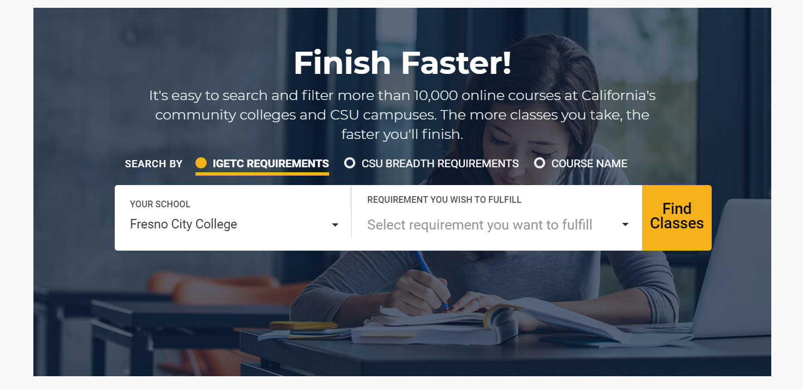
Finish Faster

Slide 48
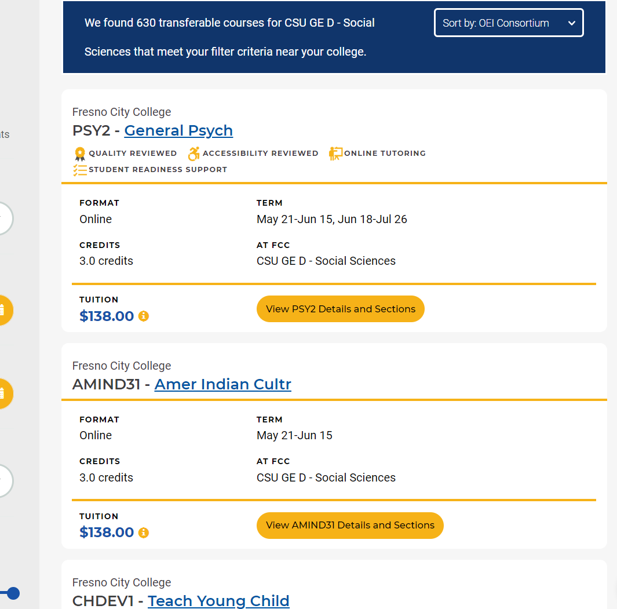
Online Courses

Slide 49
115th Online Community College

Slide 50
FCC Distance Education
 | Distance * |  |  |  |  | Face to Face
Fall | Sections | Enrollment | Success | Retention | GPA | Success | Retention | GPA
2011 | 78 | 1,859 | 63.6% | 85.1% | 2.40 | 68.8% | 90.3% | 2.39
2012 | 89 | 2,358 | 63.8% | 84.7% | 2.44 | 68.4% | 90.4% | 2.36
2013 | 92 | 2,580 | 61.4% | 85.9% | 2.29 | 68.5% | 91.0% | 2.37
2014 | 96 | 2,670 | 59.6% | 84.1% | 2.27 | 69.5% | 91.1% | 2.34
2015 | 153 | 4,614 | 63.8% | 86.4% | 2.35 | 68.7% | 90.9% | 2.33
2016 | 214 | 6,424 | 65.9% | 88.3% | 2.37 | 70.3% | 91.5% | 2.38
2017 | 250 | 6,939 | 69.6% | 88.0% | 2.58 | 70.4% | 91.5% | 2.37
* 100% and Hybrid
Notes:
As you can see we have almost tripled the number of sections offered via DE. On a positive note the this past fall success retention rates are almost the same as Face to Face. GPA of online classes was slightly higher
I believe we can address these gaps in success and retention with both professional development and additional student support, and the Office of Instruction is committed to closing these gaps.

Slide 51
Teacher’s Toolbox

Slide 52
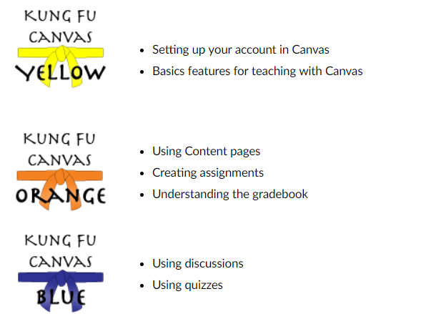
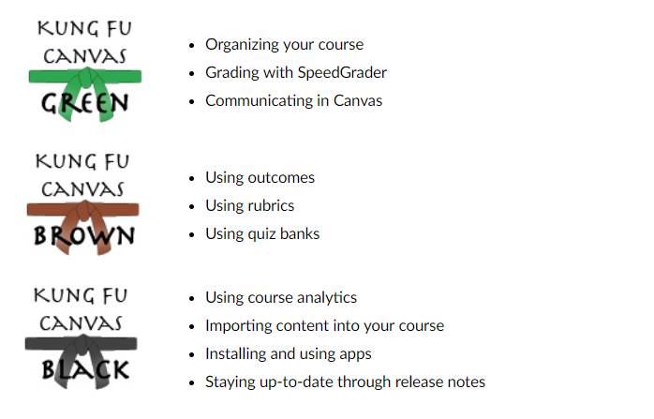
Kung Fu Canvas

Slide 53
DEC 101 (Distance Education Certification)
120 Faculty/Courses Certified in Canvas with OEI Rubric Since Spring 2017!

Slide 54
Contact/Email/Phone/VideoChat
Dr. Jodie Steeley x2246
Jon Wilson x8665
Kevin Scritchfield x2223
Zoom-Pro by name (free accounts)

Slide 55
eLumen Project

Slide 56
Project Scope
Curriculum
SLO and Assessment
Program Review
Planning

Slide 57
Project Timelines
Curriculum
Implement Fall 2018
SLO and Assessment
Implement SP2019
Program Review
Implement FA2019
Planning
Implement FA2019

Slide 58
Student Services
Dr. Lataria Hall Vice President of Student Services

Slide 59
Student Services Highlights
Ram Pantry
38,878 visits
7243 unduplicated
252.5 visits/wk
Financial Aid
2017-18 Disbursement totaled $45,680,00
2018-19 Disbursement totaling $5,600,000 disbursed in Pell
2018-19 Disbursed $230,000 in scholarships

Slide 60
Fall Enrollment
5655 new students enrolled for fall 2018
SEPA’s - 4457
SEPC’s - 127
SEPA’s & SEPC’s - 493
Total - 4584

Slide 61
Team Approach

Slide 62
Academic Benefits
Innovative team approach
Highly personalized services
Eliminates obstacles
Increases timely completion
Collaboration across divisions
Informs data driven decisions by discipline
Creates a sense of belonging for the student

Slide 63
Roles
Student Services Administrator
Academic Division Dean/Department Chair
Intervention Specialist
Financial Aid
Specialist
Counselor
Directs students to academic support programs (tutor center, ETC, PASS)
Provides students with strategies for academic success
Tracks early alert
Follows-up with students for making satisfactory academic progress
Tracks and supports students in the library technology program
Liaison between Student Services and Instructional Services
Provides leadership for Student Success Team
Supports team leader
Monitors the division data through the Student Success and Completion data dashboard
Includes Academic Division Dean/Department Chair in Student Success Team meetings
Creates student education plans
Provides major specific counseling
Establishes academic goals
Works closely with Intervention Specialist
Tracks student academic progress through Student Success and Completion data dashboard
Assists with FAFSA completion
Conducts short financial aid presentations during student success team workshops, events, etc.
Serves as a point of contact to other student success team members for financial aid questions
Monitors and identifies students on warning, disqualification, and exceeding max time frame on financial aid
Tracks incomplete FAFSA files
Liaison between Student Services and Instructional Services
Provides updates regarding majors, classes, and division
Includes Student Services team lead in all division meetings
Coordinates with Student Services Administrator in identifying student needs for the division

Slide 64
Your Major

Slide 65
Your Division
Allied Health, Physical Education, and Athletics
•
Applied Technology
•
Business Education
•
Career Technology
•
Fine, Performing, and Communication Arts
•
Humanities
•
Library & Student Learning Support Services
•
Math, Science, and Engineering
•
Social Sciences

Slide 66
Your Team
Student Services Administrator
Academic Division Dean/Department Chair
Intervention Specialist
Financial Aid
Specialist
Counselor
Contact when…
You want to create or update your student education plan
You need academic advising
You have personal concerns that may impact your education
You need guidance on the next steps for transferring
You want to explore career options
Contact when…
You are struggling academically
You are on academic probation or disqualification
An early alert has been placed on your record due to low attendance, low test scores, or anything that might take you off your educational path
Contact when…
You want to learn more about financial aid or attend a financial aid presentation or workshops
You’ve exceeded time for receiving financial aid funding
You need assistance completing FAFSA
You want to learn about borrowing money through student loans
You have a financial crisis
You become disqualified for financial aid
Your financial aid forms are incomplete

Slide 67
Working Together
Student Services
Academics/Faculty
Student Services Administrator
Division:
APA
AT
Bus
FPCA
Hum
LRC
MSE
Soc Sci
CTC
Allied Health, Physical Education, and Athletics
Applied Technology
Business Education
Fine, Performing, and Communication Arts
Humanities
Library & Student Learning Support Services
Math, Science, and Engineering
Social Sciences
Career Technology
Intervention Specialist
Counselor
Financial Aid
Specialist

Slide 68
Steps
Begin Here
Become RAM Ready
Application
Assessment
Orientation
Counseling (SEPA)
Registration
Attend RAM Ready, the new student welcome event, prior to the start of semester
Get ID card, parking permit, textbooks, and pay fees
Take campus tour to find classrooms and service areas
Learn about technology, student resources, campus life, etc.

Slide 69
Steps continued
Connect with your Success team
You will be assigned to a specific team of specialists who will provide guidance and support throughout your time at FCC. From help with financial aid to making sure you get the classes you need to stay on track, regularly scheduled check-ins with your team will make sure you’re on the path to success.
Stay on Track
Register for 15 or more units each semester
Apply for financial aid each year
Take advantage of student learning resources (tutorial center, PASS, etc.)

Slide 70
Work toward goal
Work toward your goal

Slide 71
Success
Congratulations on meeting your educational goal!

Slide 72
Accreditation
Cyndie Luna & Dr. Alan Razee
Accreditation Liaisons

Slide 73
Where We Are
Site visit & report last March
Commission reviewed report & approved FCC accreditation in June
Full accreditation for 7 years
Commendations
Recommendations

Slide 74
Recommendations to College
Syllabi should include current & correct Student Learning Outcomes (SLOs)
Student achievement plan
Library & Library Student Support Services outcomes
Administrative structure & capacity

Slide 75
Where We Are Going
Translate the Quality Focus Essay (QFE) into action
Follow-up report due Oct. 2019
Midterm report due 2022
Next accreditation visit in 2025

Slide 76
To Learn More
Direct link to accreditation materials from FCC website: “ACCJC”
Self study
Spring visit action letter
External evaluation report
alan.razee@fresnocitycollege.edu

Slide 77
Mid Program Break

Slide 78
State of the College
Dr. Goldsmith
Notes:
One of the things I heard last year was that “all levels of professional is not effective”
This also came out in our Strategic Plan…and Brice Harris will address this as well.
Core Value One: Growth We are committed to sharing and exploring new ideas through collaboration, respect for diversity, promoting equity, and professional development.
Talk about plans for PD, CUE, Inside track…and even Dr. Harris report…our need to look at ourselves and challenge ourselves to do better.

Slide 79
Guided Pathways: Looking Back, Looking Forward
Laura Hope, Executive Vice Chancellor of Educational Services and Support
August 8, 2018

Slide 80
Goal 1:
Guided Pathways
Vision for Success
Increase by at least 20 percent the number of CCC students annually who acquire associates degrees, credentials, certificates, or specific skill sets that prepare them for an in-demand job.
Goal 2:
Increase by 35 percent the number of CCC students system-wide transferring annually to a CSU or UC, necessary to meet the state’s needs for workers with baccalaureate degrees.
Goal 3:
Decrease the average number of units accumulated by CCC students earning associates degrees from approximately 87 to 79 total units—the average among the top 5th of colleges showing the strongest performance on this measure.
Notes:
Vision for Success represents aspirational goals—ambitious—but we have always been as a system

Slide 81
Goal 4:
Guided Pathways
Increase the percentage of exiting CTE students who report being employed in their field of study, from the statewide average of 60% to 69%--the average among the top 5th of colleges showing the strongest performance on this measure.
Goal 5:
Reduce equity gaps by 40% across all of the previous measures through faster improvements among traditionally underrepresented students, closing the gap within 10 years.
Goal 6:
Reduce regional achievement gaps across the previous measures through faster improvements among colleges located in regions with the lowest educational attainment of adults, with the goal of closing the gap within 10 years.
Notes:
OK

Slide 82
California’s Response to Guided Pathways
All 114 California Community Colleges have committed to the guided pathways framework!
Guided Pathways invokes unity, but not uniformity

Slide 83
Transformational Reform
Programmatic Reform
Small locus of control
Limited impact
Disconnected
Structural Reform
Collaborative control
Maximum impact
Cultural reform and integration

Slide 84
Pillars of Guided Pathways

Slide 85
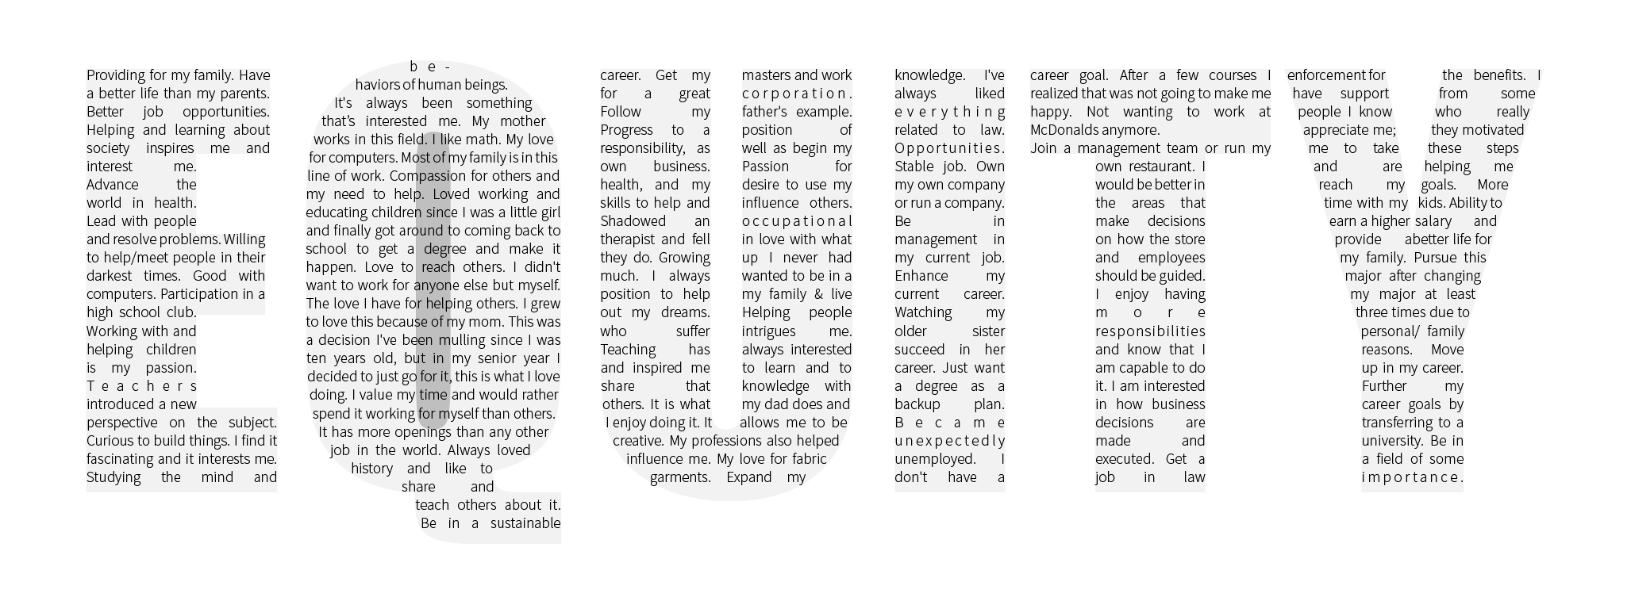
Equity

Slide 86
Self-Assessment Results
4%
Pre-Adoption
20%
In Progress
76%
Early Adoption

Slide 87
Multi-Year Work Plan Themes
Broaden engagement and connect governance
Create cross-functional team structures
Clarify decision-making and communication
Adopt systems-based language for new culture
Plan interest clusters and curriculum maps

Slide 88
Support Infrastructure Levels
System
Policy Connectivity
GP Awards Program
Virtual community
Role-Alike Events
Strategic Alignment
Funding Formula
Simplified Metrics
Intersegmental Partnerships
Regional
Regional Coordinators
Tools and Activities
Peer Communities
University Partners
Workforce Partners and Relationships
Local
Professional Development
Peer coaching
Design Teams
Governance structures
Community Accountability
K-12 Partners
Workforce Partners

Slide 89
Building Community Around Shared Goals

Slide 90
Transformational Paradigm
Inquiry
Design
Implementation

Slide 91
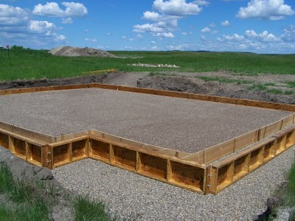
Build a Strong Foundation
Data at the center of the dialogue
Transformation not just transactions
Inclusive dialogue
Student voice and centered
Ambiguity as a norm
Evaluative intentions
Risk-tolerance and trust
Courage, courage, courage

Slide 92
Next Steps and Questions

Slide 93
Closing comments
Dr. Carole Goldsmith

Slide 94
Afternoon Agenda
Lunch on your own 12:00-1:00
Instructional and Student Services Division Meetings 1:00-3:00

Slide 95
Thank you….
Have a great semester

